Slide 1
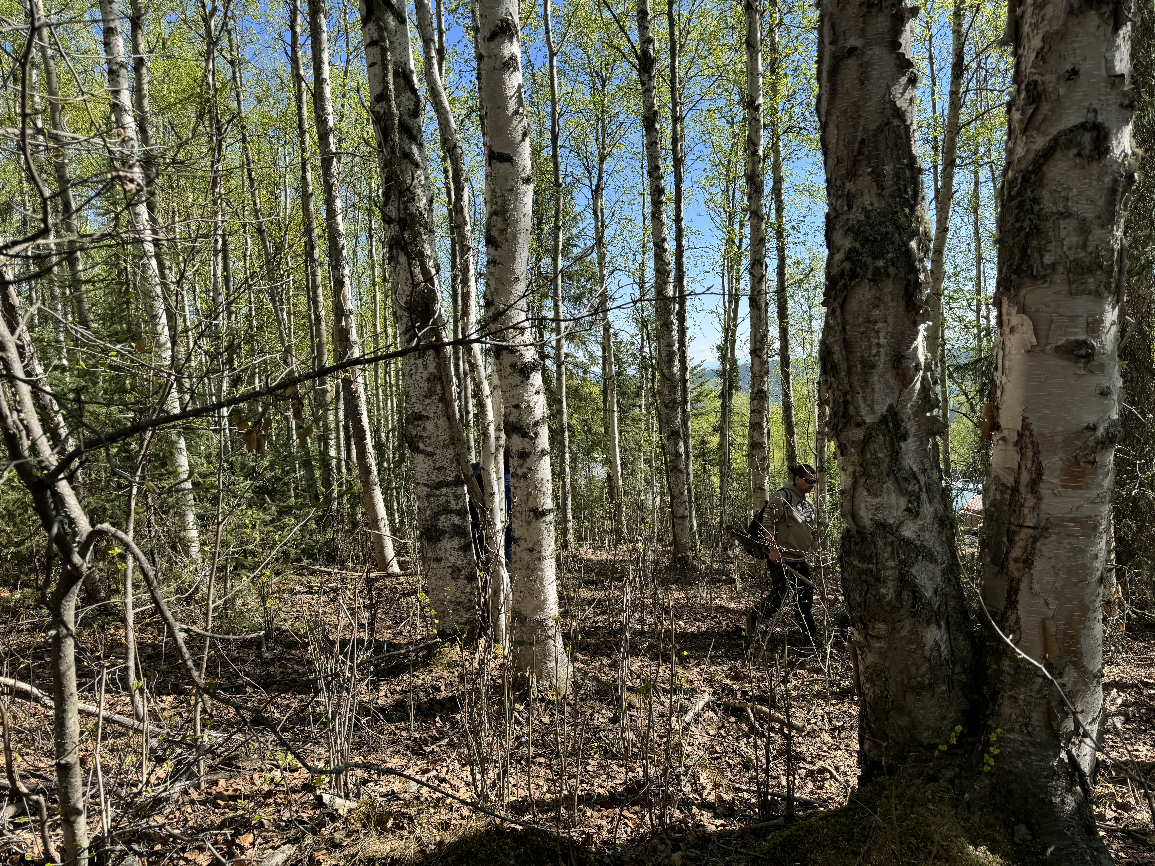
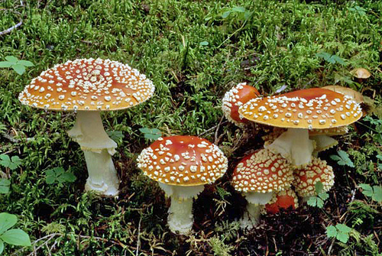


Soil Carbon Sequestration in Forestland Soils

Slide 2
Learning Objectives
Review carbon cycling in forest ecosystems, with a focus on soils.
Understand mechanisms for carbon sequestration in forest systems.
Discuss relevant conservation practices.
Articulate why carbon sequestration in forest soils matters.

Slide 3
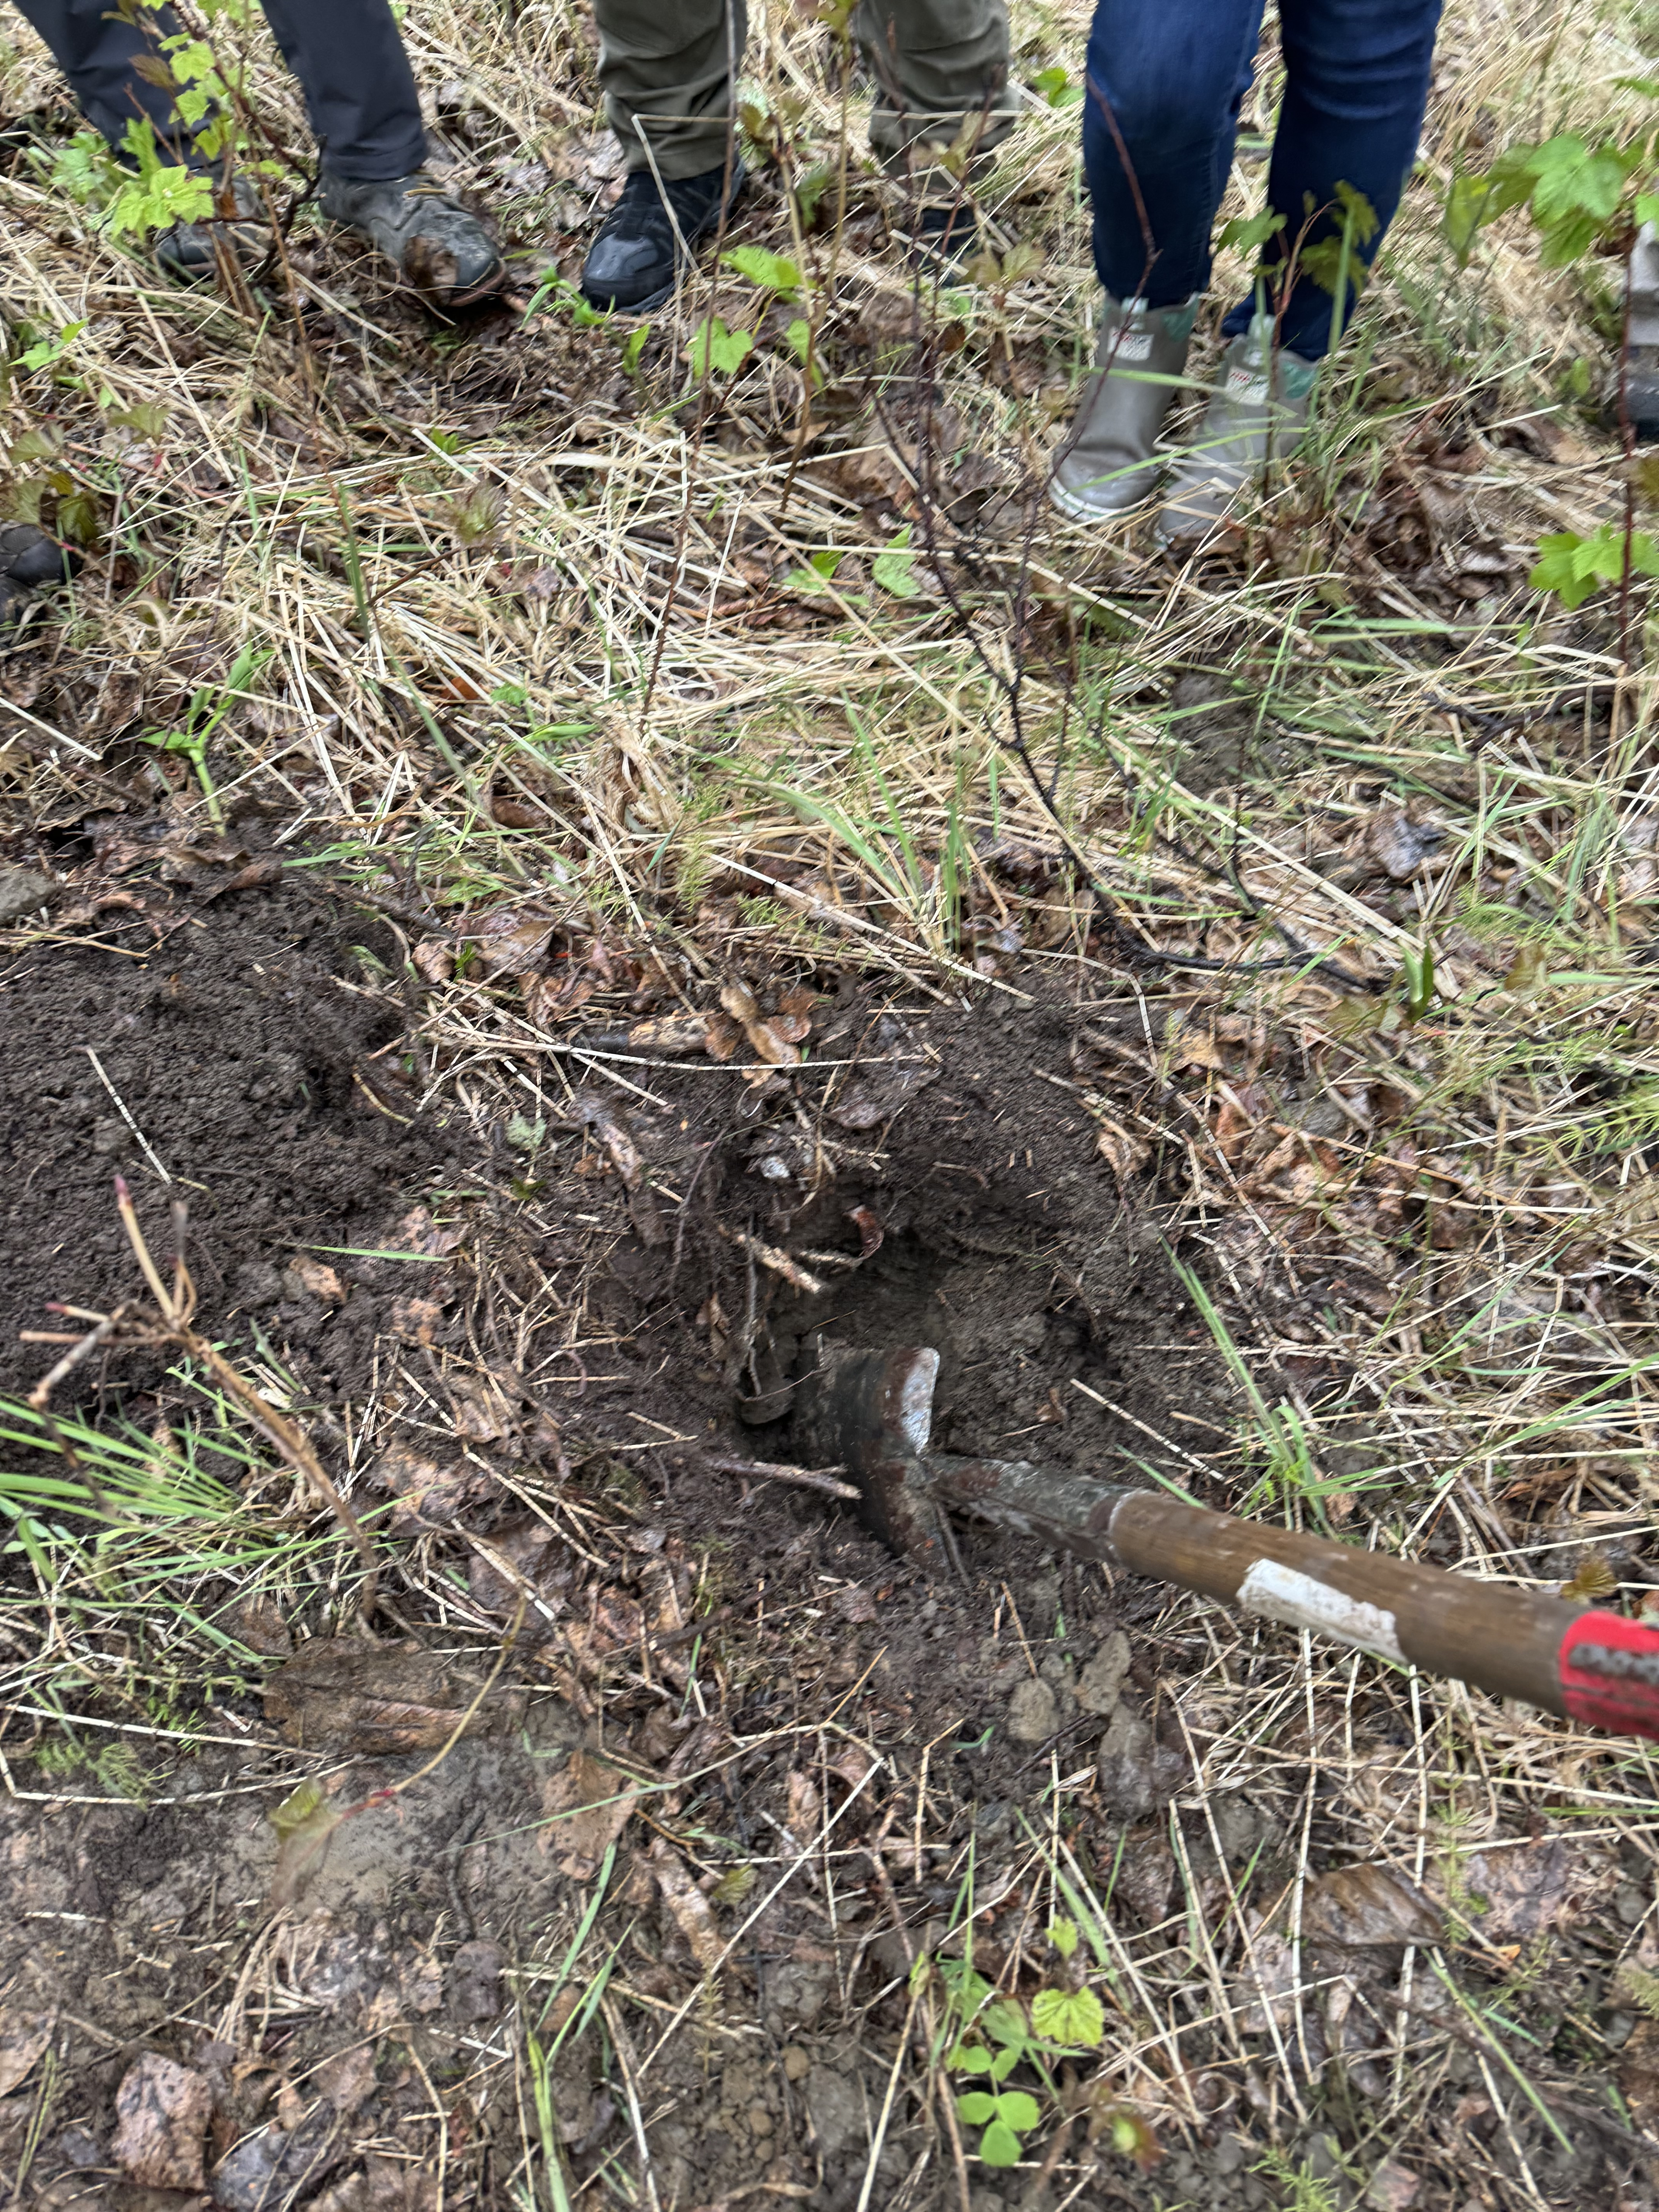
Carbon – Let’s dig in!
Where does the carbon in trees come from?
Where does the carbon in forest soil come from?
Notes:
Discuss with the class to get them thinking about the C cycle in forests.

Slide 4
Why do we care about carbon sequestration in forests?
Soil Health
Production
Improved resiliency
Carbon Markets - $$$
Notes:
Almost half of the terrestrial total organic C is stored in forest soils (Mayer et al., 2020).
Soil Health - Increased total organic C can improve water and nutrient cycling, reduce erosion and compaction, and improve aggregate stability.
Production – Improved resiliency after harvest, reduced inputs (pest, fertility), easier operations due to improved soil characteristics.
Improved resiliency to drought, and storms
Carbon Markets - $$$

Slide 5
Interesting Facts
Forests removed approximately 1/3 CO₂ emissions globally by increasing forest carbon (C) stock in 2020 (Friedlingstein et al., 2022).
Globally over 40% C (in terrestrial systems) is in forest soils.
It can take a forest 1-5 decades to begin to recover soil C stocks after harvest.
Forest soils account for a large portion of the total C stored in the ecosystem:
  70% in boreal forests
  60% in temperate forests
  30% in tropical forests
Notes:
The last point is reiterated on the next slide to promote discussion about C cycling in different forests.

Slide 6
Interesting Facts
Of the total C stored in the ecosystem, forest soils account for:
  70% in boreal forests
  60% in temperate forests
  30% in tropical forests
Why do you think there is a difference between the types of forests and how much C there is in the soil?
Notes:
Discussion: Why are there differences in the amount of C store in different forests? Climate and microbial breakdown - Balance between biomass production and residue break down.

Slide 7
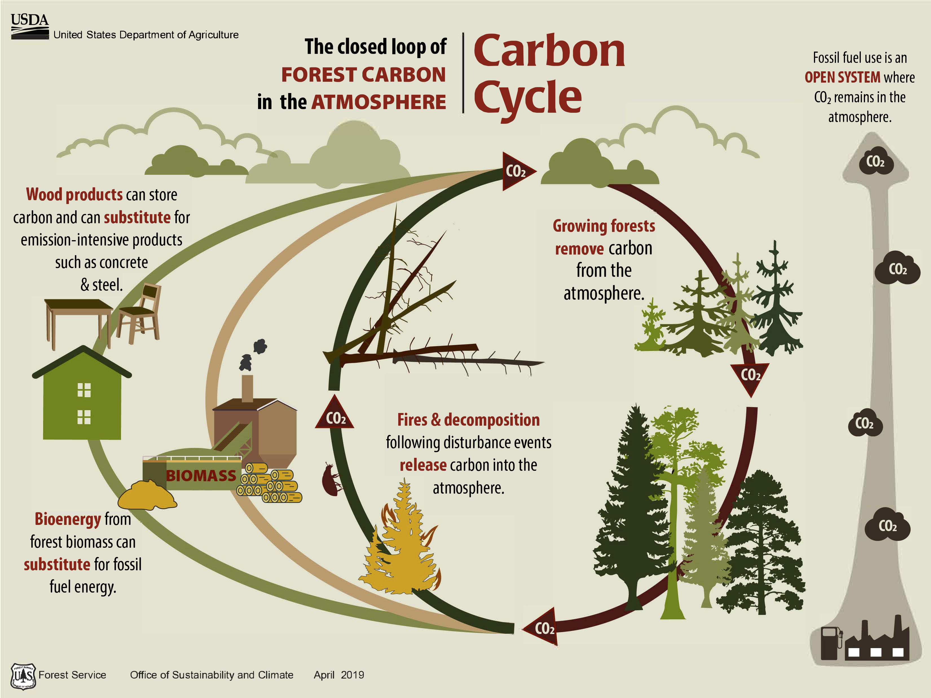
What important detail is missing from this diagram?
Notes:
Lead the class through the different components and then transition to the question to the right. Discuss the role of carbon being stored in the soil. This will be highlighted in the next slide.

Slide 8
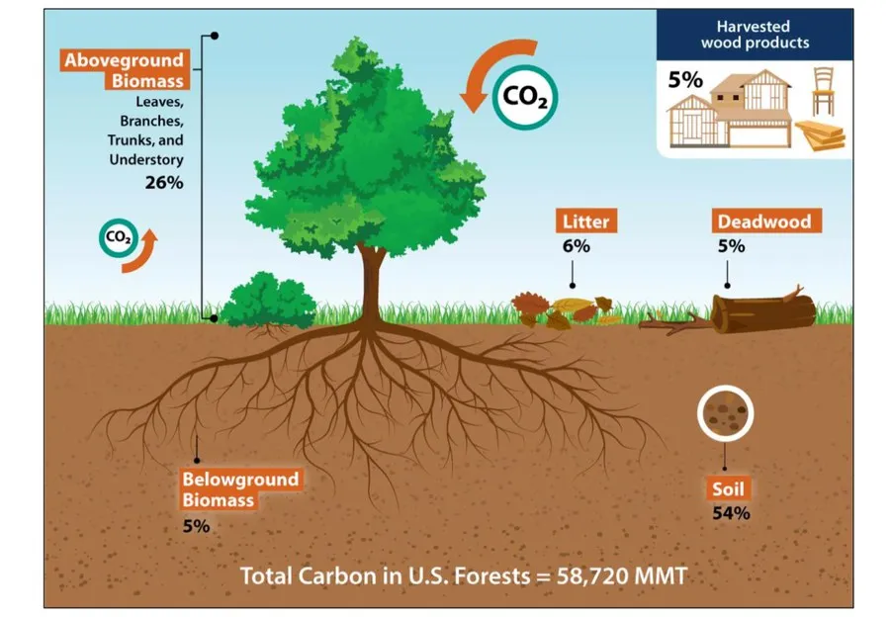
https://extension.psu.edu/forest-carbon-pools-where-are-they
Notes:
The majority of the C stored in forests is in the soil. Woody biomass is ~45% carbon on a dry weight basis. For me, this helps imagine the amount of carbon in a forest soil or in a litter layer if you imagine that, when dry, ~1/2 of the material is carbon that was taken from the atmosphere.

Slide 9
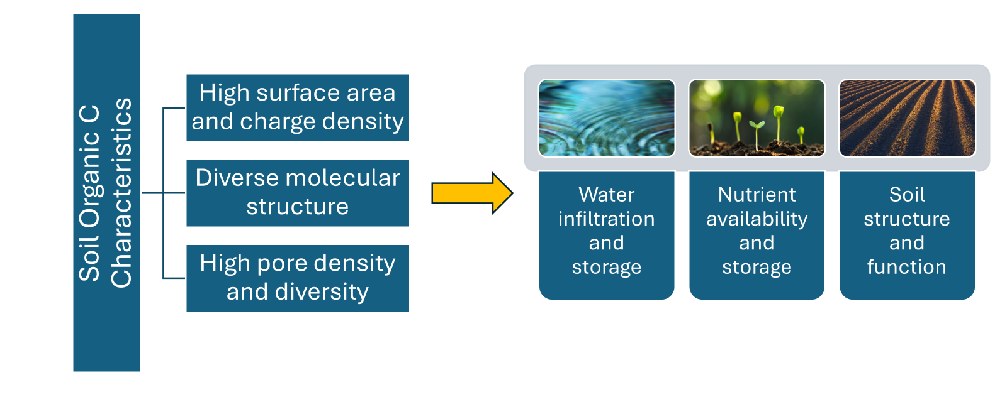
What is the link between C sequestration and soil health?
Notes:
Soil organic C (SOC) is essential to a functioning soil ecosystem (Lal, 2016). Lead the class through the figure.
Soil organic matter (40-65% SOC) is the primary source of energy for soil microorganisms.
Almost half of the terrestrial total organic C is stored in forest soils (Mayer et al., 2020).
Soil Health - Increased total organic C can improve water and nutrient cycling, reduce erosion and compaction, and improve aggregate stability.
Production – Improved resiliency after harvest, reduced inputs (pest, fertility), easier operations due to improved soil characteristics.
Carbon Markets - $$$

Slide 10
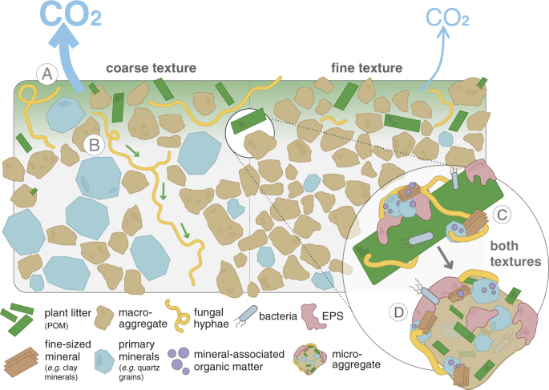
How is carbon stored in the soil?
Figure from Witzgall et. al 2021
Notes:
This figure and following figure caption are from Nature article - Witzgall et al. 2021. Particulate organic matter as a functional soil component for persistent soil organic carbon. The figure caption “Aggregate and mineral-associated organic matter formation in soils of different textures driven by interactions between litter, microorganisms, and soil matrix. Fresh litter surfaces serve as hotspots of microbial activity driving the formation of organo-mineral associations in concert with comprising a nucleus for aggregate formation. A Coarse soil texture fosters higher mineralization of native and litter-derived organic matter resulting in higher CO2 emissions compared to the fine-textured soil. B Fungal hyphae in coarse-textured soils promote the translocation of litter-derived C away from the litter
source. C Regardless of texture, gluing of fine-sized minerals, driven by microbial products (EPS) on the fresh litter surface leads to (D) the formation of soil
aggregates directly at the plant-soil interface.”

Slide 11
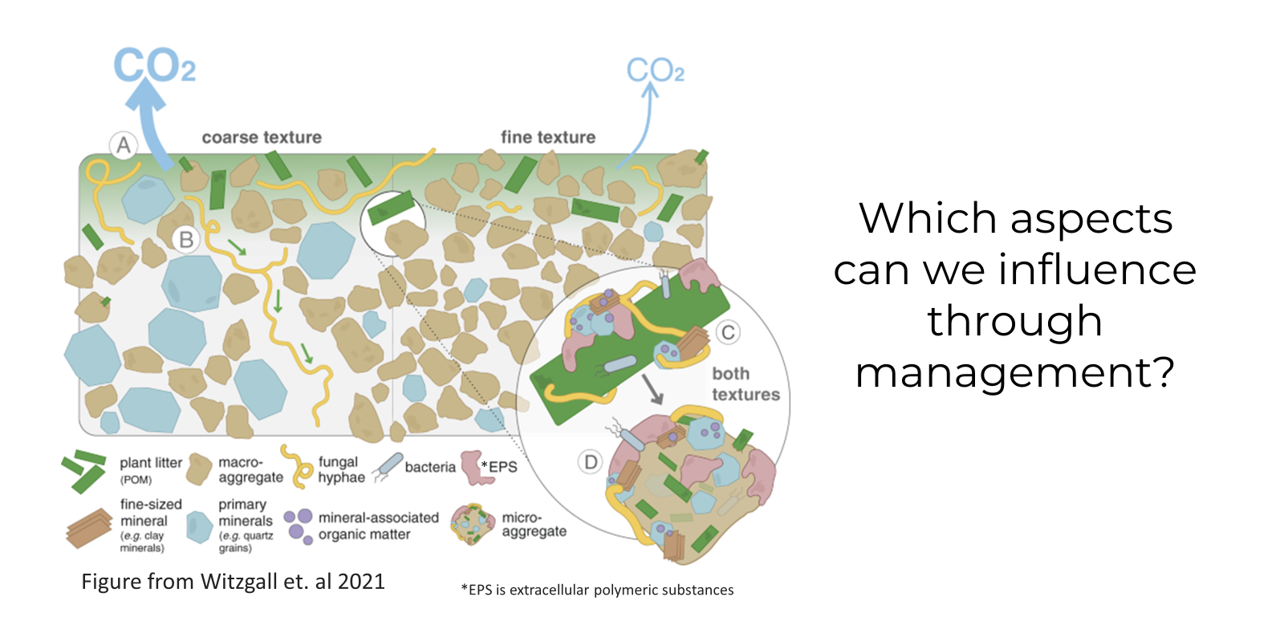
How is carbon stored in the soil?
Notes:
Ask the class which aspects of the carbon storage we can influence through forest management.

Slide 12
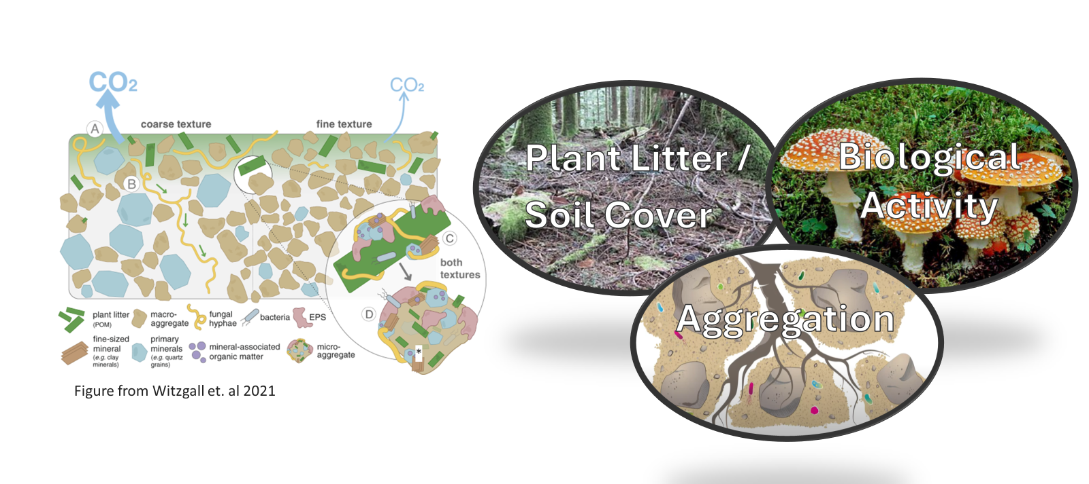
Management and C storage
Notes:
Prompt class the discuss forest management practices that improve soil cover, biological activity, and aggregation. Add common practices from your area and discuss how they relate to the four soil health principles (maximize cover, minimize disturbance, maximize diversity, and maximize living roots). We will discuss each of these components further on in the presentation.

Slide 13
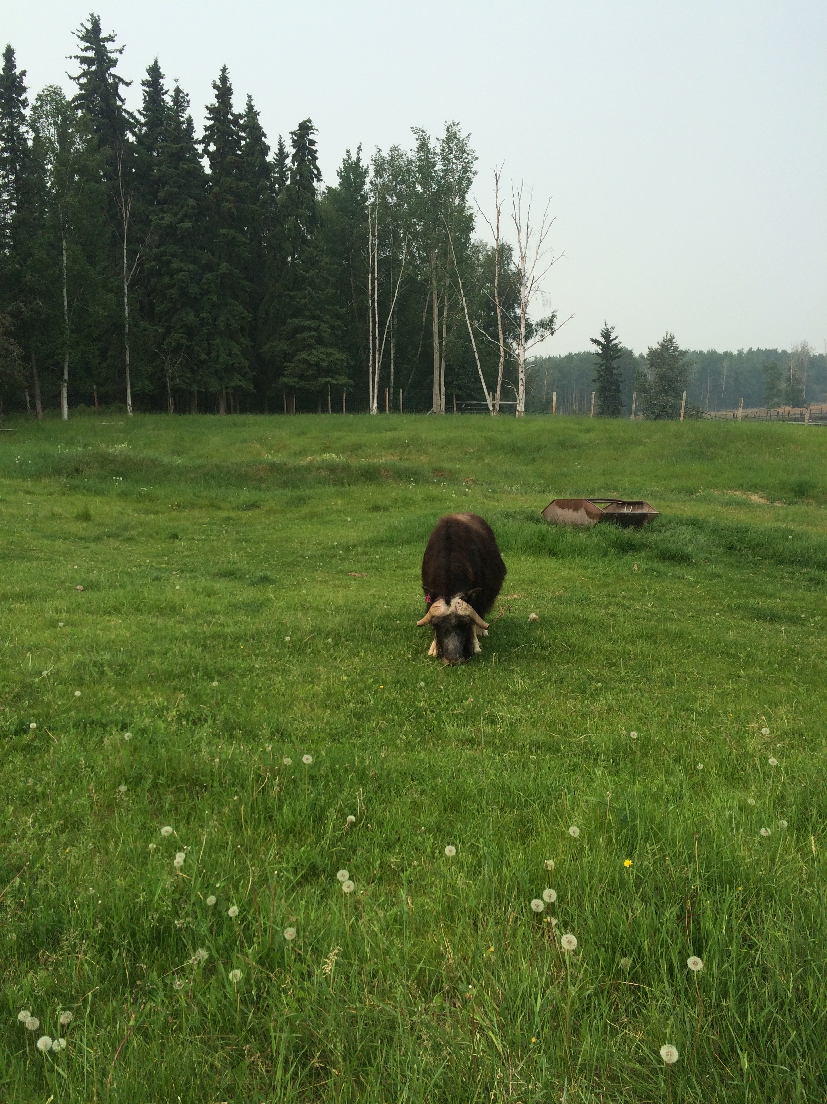
Discussion
What are the differences between crop and forest soil?
What does that mean for C storage?
*
Notes:
Lead the discussion to the differences between perennial and annual crops, the length of time between harvests (and other disturbance), management intensity, and diversity. Compare common cropping systems to forest systems in the area. Think about how these differences impact the 4 soil health principles and how carbon is stored in the soil.

Slide 14
What are soil aggregates?
Naturally forming clusters of sand-, silt-, and clay-sized soil particles that are held together by physical, biological, and chemical forces.
Slide courtesy of Dr. Sharon Perrone, USDA-NRCS
Notes:
Most of you are familiar with this, but it’s always nice to orient ourselves as we get started – aggregates are naturally forming clusters of sand-, silt-, and clay-sized soil particles that are held together by forces much stronger than those holding adjacent aggregates together.

Slide 15
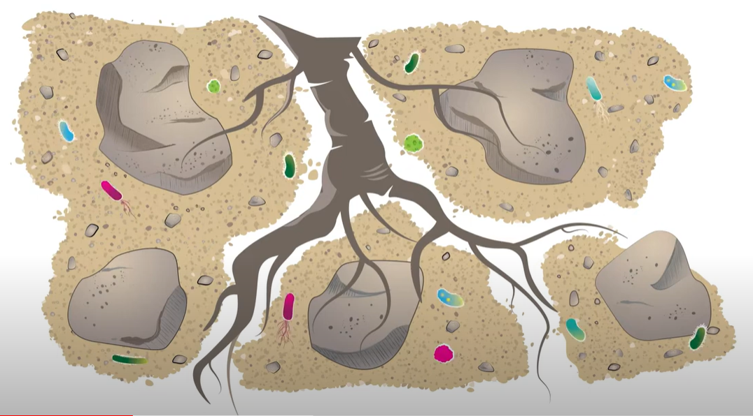
pore space for water infiltration, gas exchange, and root growth
sand
microbes
silt
microscopic clay and organic matter
(diagram and contents are not to scale)
Slide courtesy of Dr. Sharon Perrone, USDA-NRCS
Notes:
And conceptually that’s going to look something like this – we see sand, silt, and clay-sized particles stuck together in clusters with bacteria, fungi, and organic matter. We see the space in between aggregates as pores for water infiltration, gas exchange, root growth, and also highways for macroinvertebrate movement through soil. In this case, we also see the root serving as a connector to hold multiple aggregates together.

Slide 16
Why do we care about aggregates?
Aggregates…
physically protect soil organic matter
influence microbial community structure
regulate oxygen and CO₂ diffusion
regulate water flow
determine nutrient adsorption and desorption
Notes:
Soil aggregates protect soil organic matter by physically occluding it from degradation. Good aggregation promotes optimal air and water balance, and organic matter storage in the soil, which in turn provides diverse habitats for microorganisms, and can help to provide nutrients to the community.

Slide 17
Formation of soil aggregates
Micro:
≤ 250 µm
Macroaggregates - More biologically mediated process
  Formed by processes such as root and fungal hyphae growth
  Formed by soil organism particle movement, exudation of polysaccharides and glycoproteins, and decomposition of organic residues
  Evidence that microaggregates are formed in macroaggregates (Six et al., 2004)
Macro:
> 250 µm
Slide courtesy of Dr. Sharon Perrone, USDA-NRCS
Notes:
And it’s important to understand that macroaggregates and microaggregates are formed differently. Macroaggregates are formed by plant and microbial processes such as exudation and decomposition as well as soil fauna such as earthworm mucus. In contrast, microaggregates are formed by microbial and abiotic processes, may be held together by chemical binding agents such as clays, aluminum and iron oxides, hydroxides, and oxyhydroxides, and carbonates. Microaggregates are also more likely to contain stabile, long-term carbon. The formation of aggregates is highly reliant on soil organisms. Improving biological activity is key consideration to improve aggregation.

Slide 18
Formation of soil aggregates
Micro:
≤ 250 µm
Microaggregates – more mediated by physical and chemical processes
  Formed by abiotic soil properties and microbial exudation of polysaccharides and glycoproteins
  May be held together by clays and Al- and Fe-(hydr)oxides, carbonates
  More likely to maintain long-term C (stabile)
Macro:
> 250 µm
Slide courtesy of Dr. Sharon Perrone, USDA-NRCS
Notes:
And it’s important to understand that macroaggregates and microaggregates are formed differently. Macroaggregates are formed by plant and microbial processes such as exudation and decomposition as well as soil fauna such as earthworm mucus. In contrast, microaggregates are formed by microbial and abiotic processes, may be held together by chemical binding agents such as clays, aluminum and iron oxides, hydroxides, and oxyhydroxides, and carbonates. Microaggregates are also more likely to contain stabile, long-term carbon. The formation of aggregates is highly reliant on soil organisms. Improving biological activity is key consideration to improve aggregation.

Slide 19
Formation of soil aggregates
Macroaggregates can form first via soil structural stabilizers such as roots and fungal hyphae; microaggregates form within these protected structures.
Old, free microaggregates can agglomerate into macroaggregates through the addition of fresh organic inputs.
Slide courtesy of Dr. Sharon Perrone, USDA-NRCS
Notes:
Microaggregates and macroaggregates form differently. READ.

Slide 20
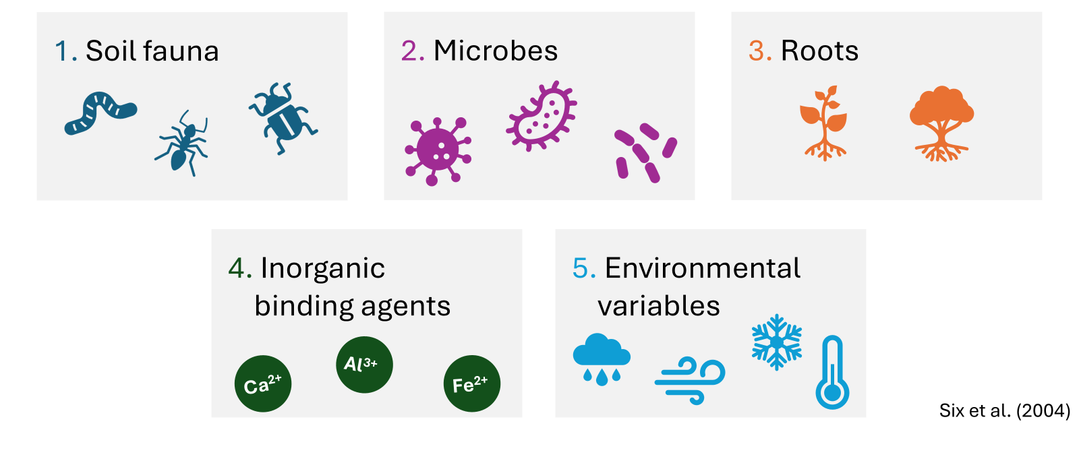
5 main controls on aggregation
Slide courtesy of Dr. Sharon Perrone, USDA-NRCS

Slide 21
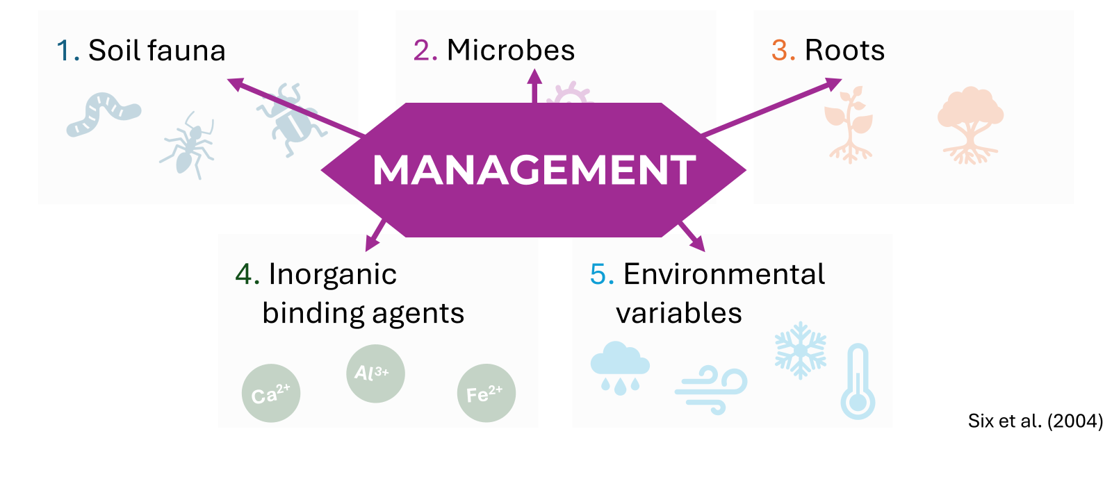
5 main controls on aggregation
Slide courtesy of Dr. Sharon Perrone, USDA-NRCS

Slide 22
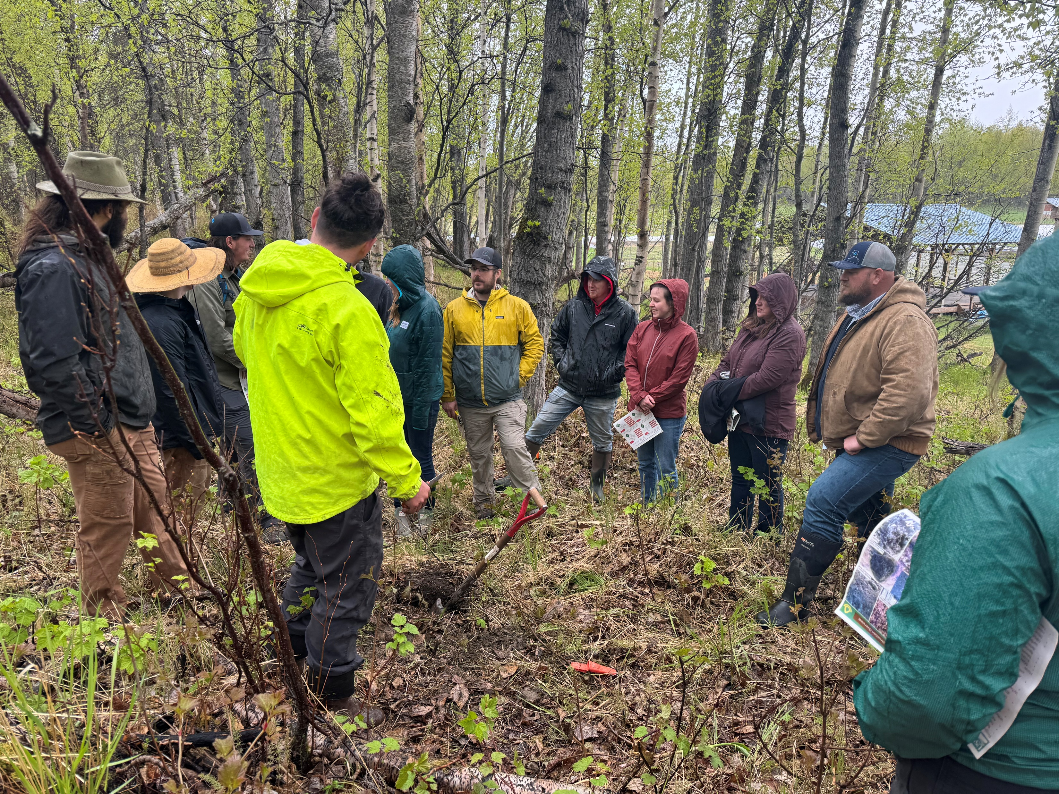
Managing plant residue/soil cover
How does litter management impact C storage and soil health?
What considerations should we discuss when managing for soil cover/plant litter in forests?

Slide 23
Where do soil biota fit in with C sequestration?
Soil Organisms
Decompose organic residues.
Exude polysaccharides and other extracellular polymeric substances
Form macroaggregates
Improve plant biomass production, suppress pests, and modify nutrient availability and/or slow decomposition.
Most of the stable SOC is derived from roots and fungi.
Notes:
Tree species mediate the plant-microbial interaction and microbial community structure. Microbes decompose organic residues. The moisture, temperature, C:N ratios, and soil pH will influence residue breakdown and C storage. Some microbes can improve biomass production, suppress pests, and modify soil characteristics to improve nutrient availability and/or slow decomposition.

Slide 24
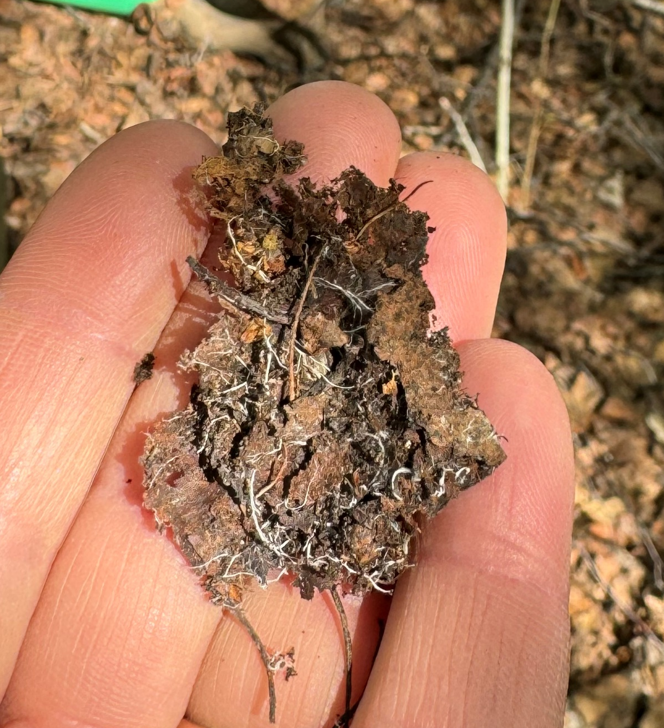
Where do soil biota fit in with C sequestration? Example:
Ectomycorrhizal fungi (EMF) - boreal and temperate forests.
Plants with EMF associations increased biomass by 30% in response to elevated CO2 regardless of N availability (Terrer et al., 2016).
EMF produce N degrading enzymes that improve the plants access to organic N.
Increased biomass and fungal activity can increase aggregation and C storage.
Notes:
As previously discussed soil biota are responsible for the decomposition and cycling of organic residues. They play a key role in the soil mixing and aggregation process. Not only can they help store carbon but also play a key role in making nutrients available.
Approx. 94% plants have an association with mycorrhizal fungi. Arbuscular mycorrhizal fungi dominate in grasslands, shrublands, and tropical forests, compared to boreal and temperate forests where Ectomycorrhizal fungi (EMF) are dominant. A good example of the importance of soil organisms is the EM fungi. A research synthesis showed that plants with EMF associations increased biomass by 30% in response to elevated CO2 regardless of N availability (Terrer et al., 2016). Suggests that EMF produce N degrading enzymes that improve their access to organic N, thereby increasing above and below ground plant growth.

Slide 25
Managing C in forest soil
Tree species had a stronger influence on SOC than tree diversity (Mayer et al, 2020).
Mixed forests favored SOC (Makipaa et al., 2023).
Managing stand density had a small impact on SOC (Mayer et al, 2020) / High stand density increased SOC (Makipaa et al., 2023).
Conifer forests accumulate more C on the forest floor, which may make it more vulnerable to disturbance (Makipaa et al., 2023).
Deciduous forest accumulate more C in the mineral soil (Mayer et al., 2020).
Forests dominated by conifer accumulated more SOC (Makipaa et al., 2020).
Notes:
Research can help us make management decisions. The Makipaa et al. (2023) and Meyer et al (2020) are review articles that summarize research so that we can make some general conclusions, however these conclusions may be generally applicable but may not apply to every site and situation. Forest manager goals and addressing resource concerns should be the primary focus.

Slide 26
Managing C in forest soil
Action | Positive | Negative | Neutral
Afforestation of cropland | X
Afforestation of grassland or peatland |  | X | X
Change of primary forests to secondary forests |  | X
Removal of biomass from harvest, grazing, residue removal |  | X
Harvesting when soils are frozen (compared to not frozen) | X
Extending harvest rotations (compared to shorter rotations) | X
Stem only harvest (compared to whole tree) | X
Managing stand density – light thinning | X |  | X
Prescribed burning (compared to wildfires incidents) | X
Addition of nitrogen (but can increase N₂O emissions) | X
Notes:
This table is a summary of the effects of different management choices on C sequestration from Makipaa et al. (2023) and Mayer et al (2020) syntheses.

Slide 27
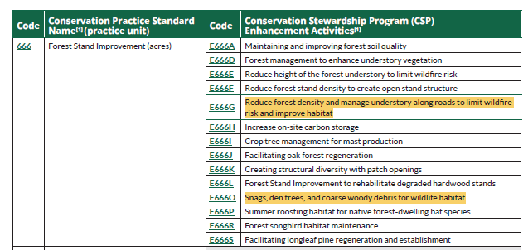
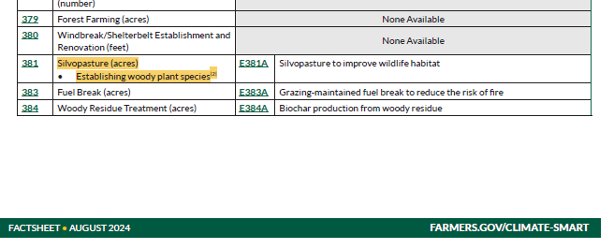
Notes:
379 Forest Farming, 383 Fuel Break, 384 Woody Residue Treatment, and 666 Forest Stand Improvement (among many others)

Slide 28
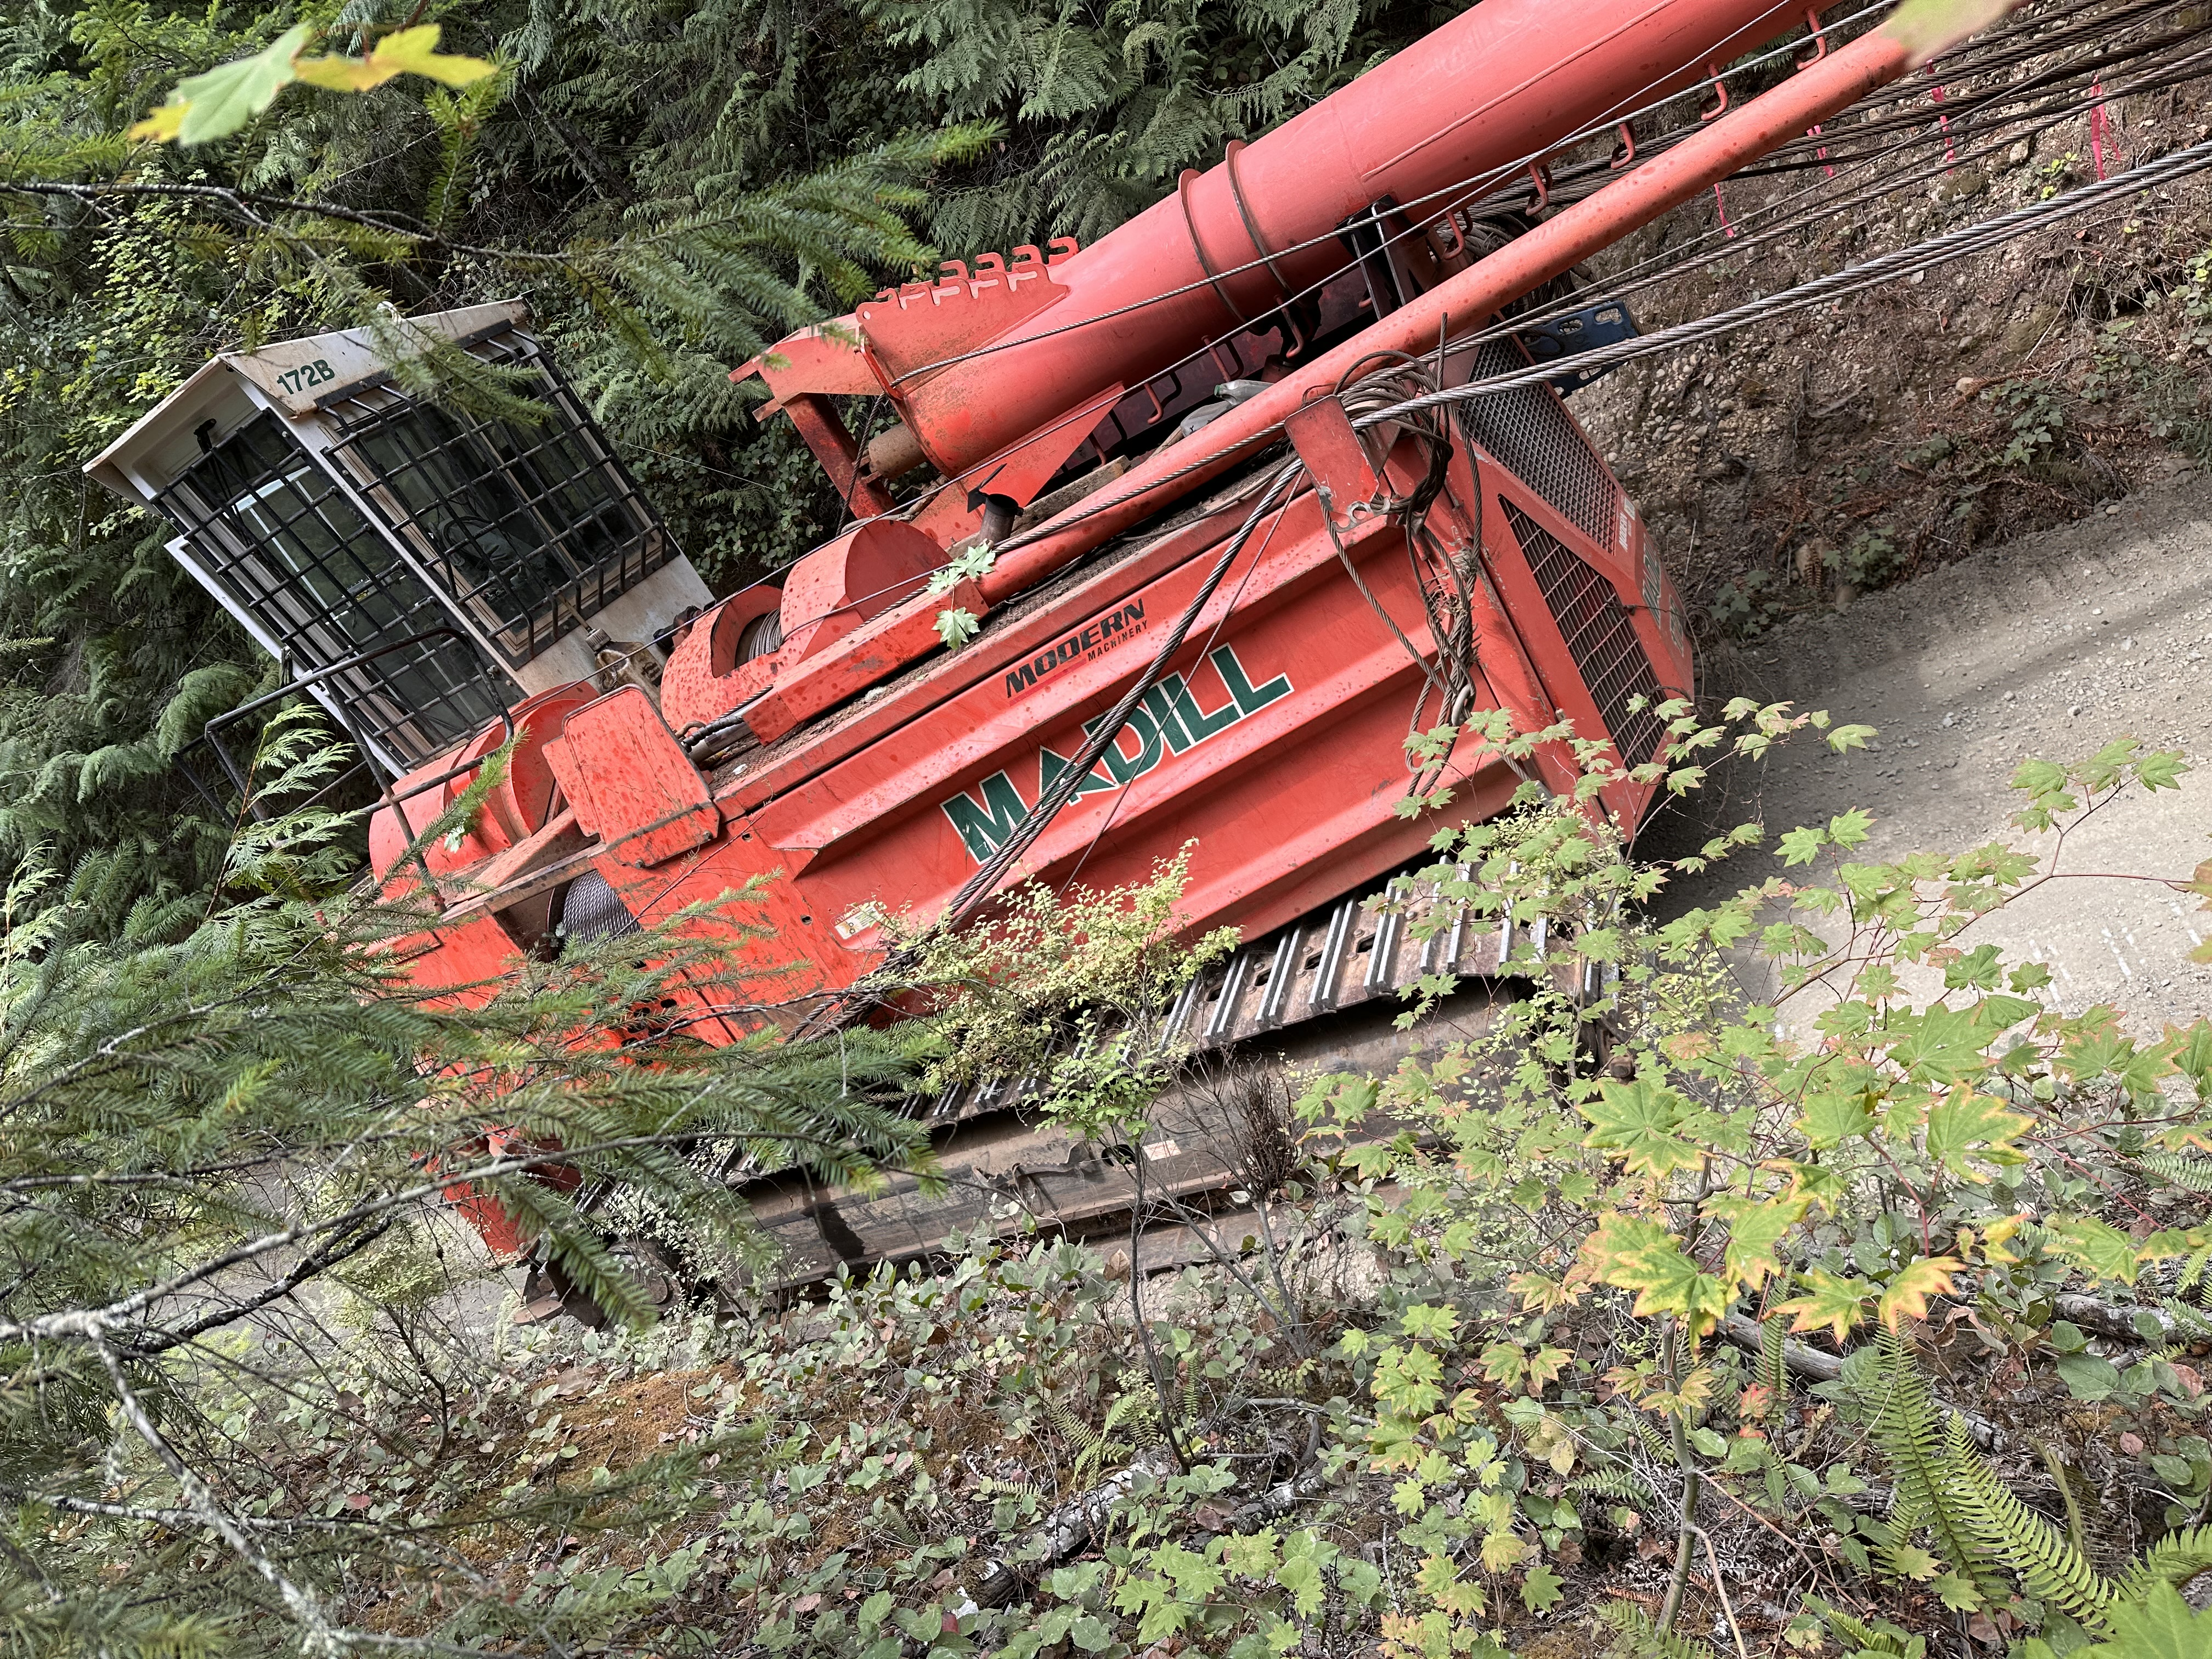
Practices to increase C sequestration
Conservation Cover (327)
Prescribed Burning (338)
Fuel Break (383)
Woody Residue Treatment (384)
Nutrient Management (590)
Tree and Shrub Establishment (612)
Forest Stand Improvement (666)
What soil health principles are being used?
Notes:
Discuss what soil health principles are being used in these practices

Slide 29
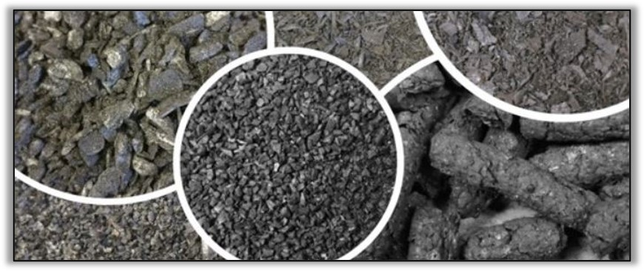
CPS 336 – Soil Organic Amendments
Photo: Kristin Trippe, USDA ARS
Compost, biochar, or other organic amendments such as wood chips can be applied.
Can be used on forest lands.
Notes:
Some additional information on CPS 336 – can be used on forests

Slide 30
CPS 336 – Soil Organic Amendments
Meta-analysis (Thomas and Gale, 2015) found:
  Potential for 41% mean growth increase
  Greater effect when applied in early growth stage, boreal and tropical systems, and deciduous trees
  Great promise to replace liming agent and other organic amendments.
Discussion:
When does it make sense to use this practice in forests?
What are some of the considerations when applying?
Notes:
A meta-analysis by Thomas and Gale found that biochar had positive effects on tree growth. Discuss when this practice might be appropriate (or not).
Some considerations should be cost, pH and nutrient impacts (potential to increase pH and add nutrients such as P), and heavy metal contaminant issues. This practice has potential but must be carefully planned as it can have serious ramifications.

Slide 31
CEMA 221 - Monitoring soil carbon stocks
“Used to estimate carbon stocks and track trends when data are aggregated across many producers.”
“Soil organic carbon storage should be measured before and after the implementation of a conservation practice, system, or activity.”
Evaluation and monitoring of change usually requires several years (e.g., >5 years).”
Notes:
Language from CEMA 221 to explain the purpose for carbon monitoring. This CEMA should be considered in the planning process in order to monitor C storage in the soil.

Slide 32
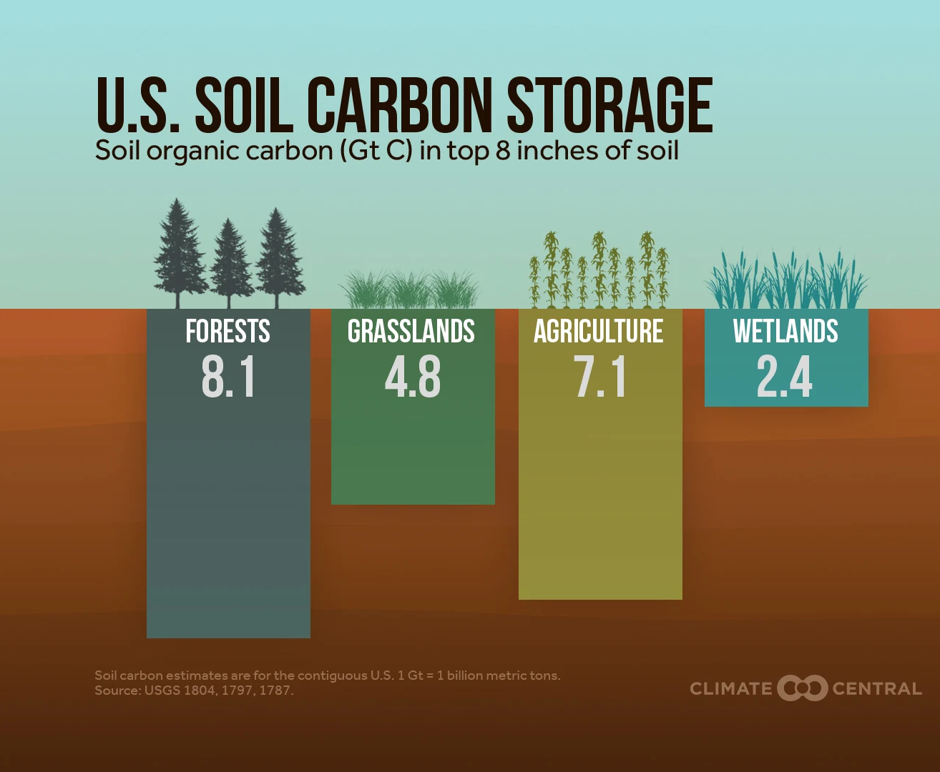
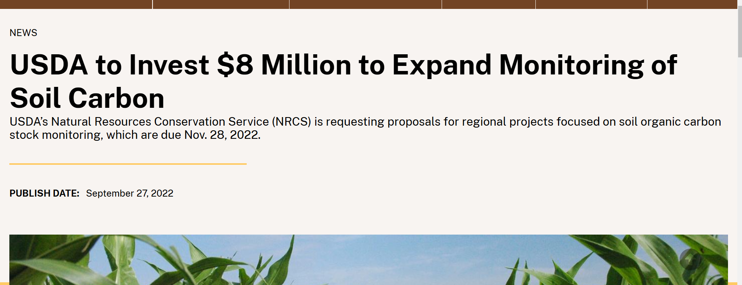
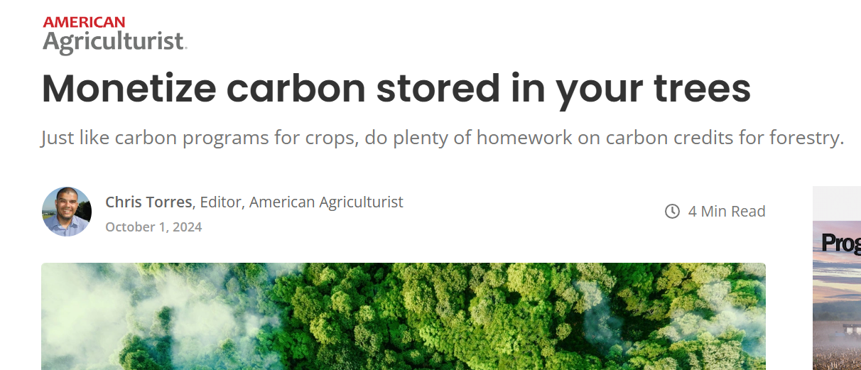
How does CEMA 221 fit with C markets?
Notes:
There is a lot of potential to store C through forest management. Planners should be aware that landowners may have questions about C markets, NRCS practices, and CEMA 221.

Slide 33
How does CEMA 221 fit with C markets?
Forests may have high potential for C sequestration and producers with forest may be especially interested in C markets.
Methods in CEMA 221 are consistent with industry standards.
Frey et al. (2021) found that the average payment for forest ecosystems services (includes C sequestration) from 2010-2019 was $17.69 ha⁻¹ or $7.16 ac⁻¹.
Interested participants should use caution and seek legal advice before entering in an C market agreement as terms and payments vary widely.
Notes:
Some considerations for C markets and CEMA 221.

Slide 34
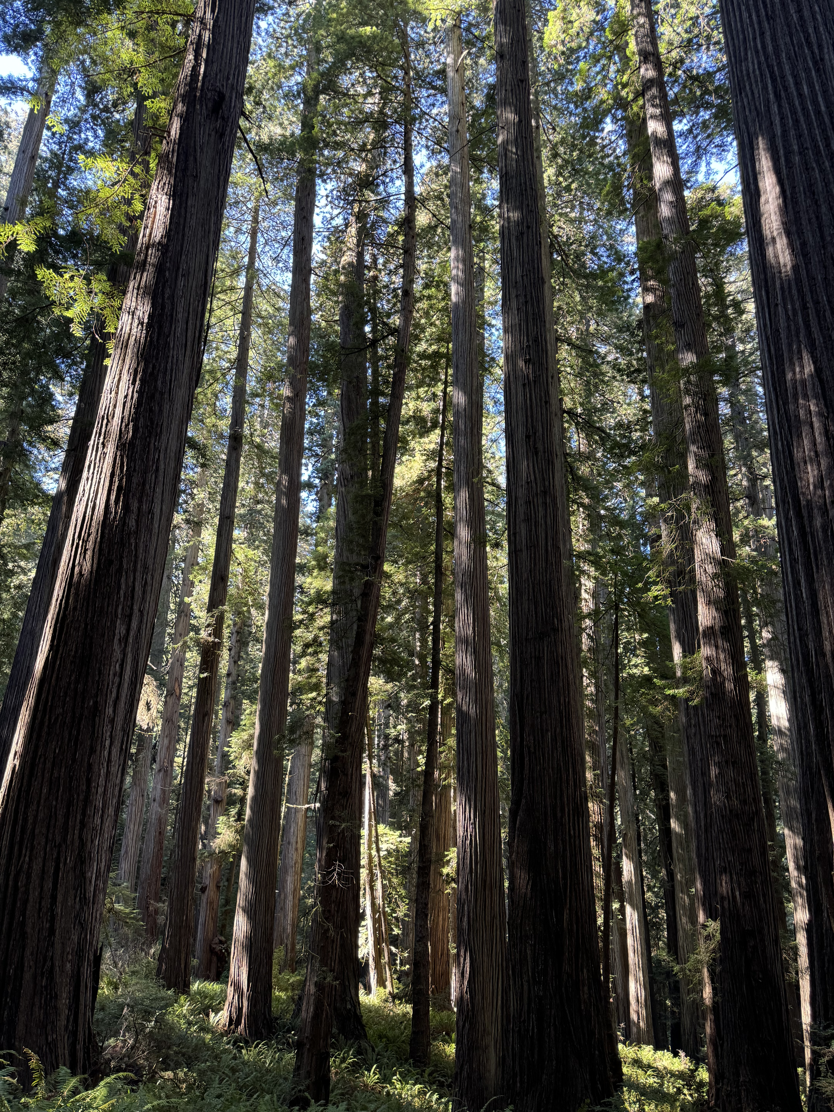
Discussion
Have you spoken to landowners who are interested in C markets?
Notes:
What is your experience with forest owners and C markets? Is anyone participating in the market place? Have you been asked questions about it?

Slide 35

Questions?
Notes:
Transition to questions or comments for the module. The photo is of a California Redwood. In the white circle are the people.

Slide 36
References
Frey, G.E., Kallayanamitra, C., Wilkens, P., & James, N.A. (2021). Payments for forest-based ecosystem services in the United States: Magnitudes and trends, Ecosystem Services, 52, 101377, https://doi.org/10.1016/j.ecoser.2021.101377.
Mäkipää, R., Abramoff, R., Adamczyk, B., Baldy, V., Biryol, C., Bosela, M., ... & Lehtonen, A. (2023). How does management affect soil C sequestration and greenhouse gas fluxes in boreal and temperate forests? – A review. Forest Ecology and Management, 529, 120637.
Mayer, M., Prescott, C. E., Abaker, W. E., Augusto, L., Cécillon, L., Ferreira, G. W., ... & Vesterdal, L. (2020). Tamm Review: Influence of forest management activities on soil organic carbon stocks: A knowledge synthesis. Forest Ecology and Management, 466, 118127.
Terrer, C., Vicca, S., Hungate, B. A., Phillips, R. P., & Prentice, I. C. (2016). Mycorrhizal association as a primary control of the CO2 fertilization effect. Science, 353(6294), 72-74.
Thomas, S.C., and Gale, N. (2016). Biochar and forest restoration: a review and meta analysis of tree growth responses. New Forests, 46:931–946. DOI 10.1007/s11056-015-9491-7
Witzgall, K., Vidal, A., Schubert, D.I. et al. 2021. Particulate organic matter as a functional soil component for persistent soil organic carbon. Nature Communications, 12, 4115. https://doi.org/10.1038/s41467-021-24192-8

Slide 37
Thank you!
For more information on Managing Soil Health,
visit us here:
https://www.nrcs.usda.gov/conservation-basics/natural-resource-concerns/soils/soil-health
USDA is an equal opportunity provider, employer, and lender.

